Slide 1

ENPM-665: MID TERM
E-Commerce Platform Security
Assessment Presentation

Slide 2
GROUP - 4
Bhavna Kumari UID 121394514
Rakshana Muthukumar UID 121116393
Harshit Dharani UID 121014221
Semileniola Bernice Salako UID 121394019
Priyanka Nateshan Iyer UID 121389305

Slide 3
Web Application Vulnerabilities

Slide 4
Vulnerability Assessments
1. SQL Injection (SQLi)
Description: It occurs when an application uses unsanitized user input directly in an SQL queries.
Example: ' OR TRUE-- to login as admin.
Impact: Authentication bypass, data leakage.
Risk Level: Critical
Recommendation: Use parameterized queries.
2. Broken Access Control
Description: It occurs when users can access resources or perform actions outside of their authorized permissions due to weak or missing access restrictions.
Example: Tampering the request to view a basket, it was possible to access other users' baskets.
Impact: Unauthorized access to sensitive data leading to data breaches or complete system takeover.
Risk Level: Critical
Recommendation: Enforce role-based access control (RBAC), validate user permissions server-side, and never rely on client-side controls for authorization.
Group - 4

Slide 5
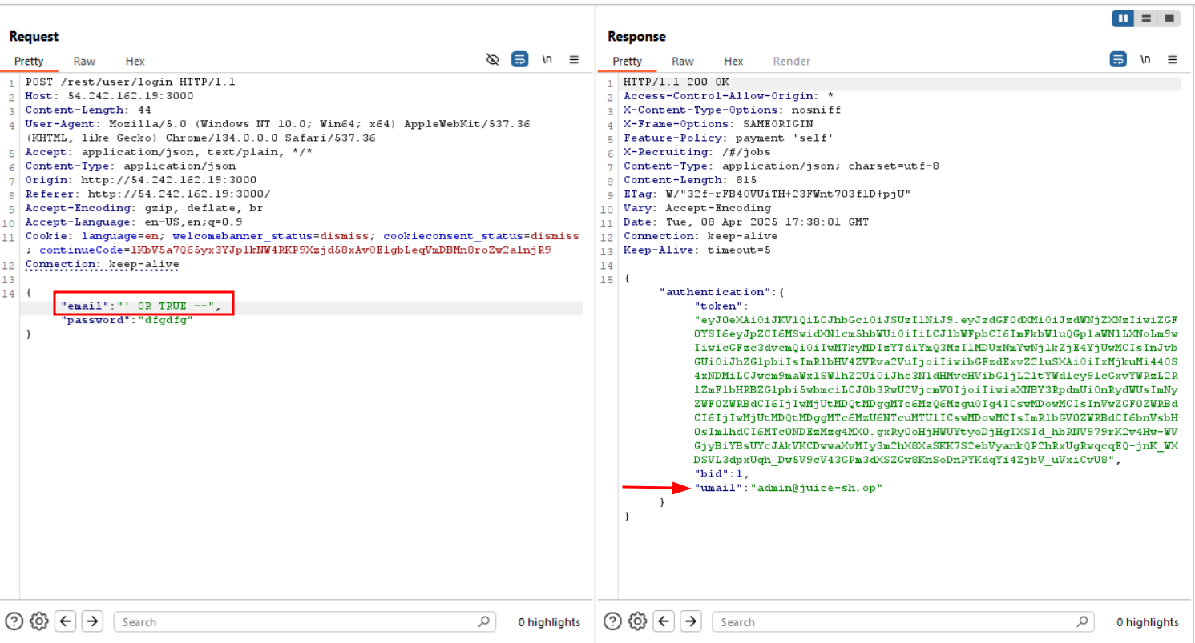
SQL Injection: Able to get the administrator email address
Group - 4

Slide 6
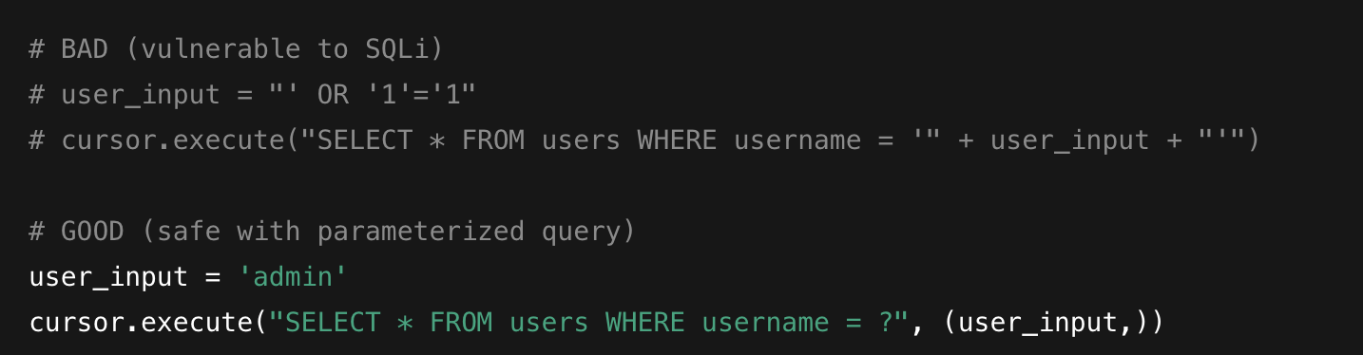
SQL Injection:
Group - 4

Slide 7
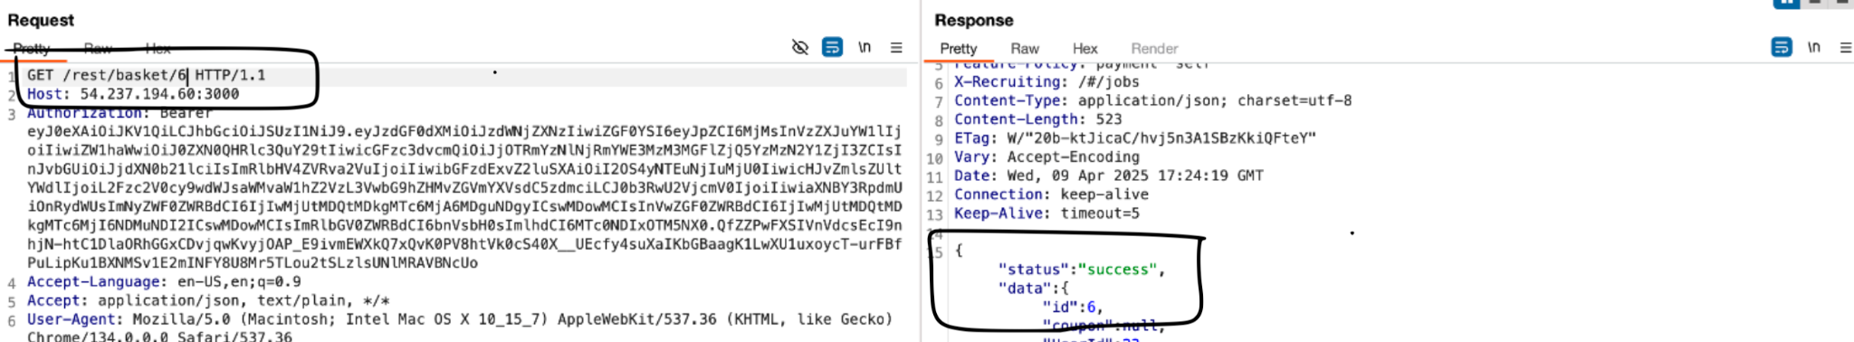
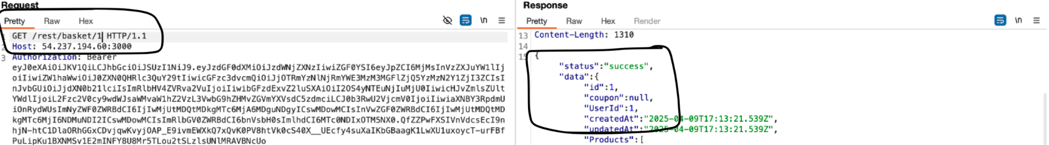
Broken Access Control:
Group - 4

Slide 8
Cross-Site Scripting (XSS) & Mitigations
3. Reflective Cross Site Scripting (XSS)
Description: It occurs when unsanitized user input is injected into web pages without proper validation or encoding, allowing attackers to execute malicious scripts in users' browsers.
Example: <img src=x onerror=alert('XSS')> executed via product search input triggered an alert box.
Impact: Can lead to session hijacking, data theft, or redirect attacks compromising both data and user trust.
Risk Level: High
Recommendation: Sanitize and encode all user inputs, Use Content Security Policy (CSP), Avoid directly inserting user input into HTML.
Mitigation Best Practices
Input validation on both client & server side
Output encoding before rendering data
Secure cookies (HttpOnly, Secure flags)
Regular security testing (e.g., OWASP ZAP)
Group - 4

Slide 9
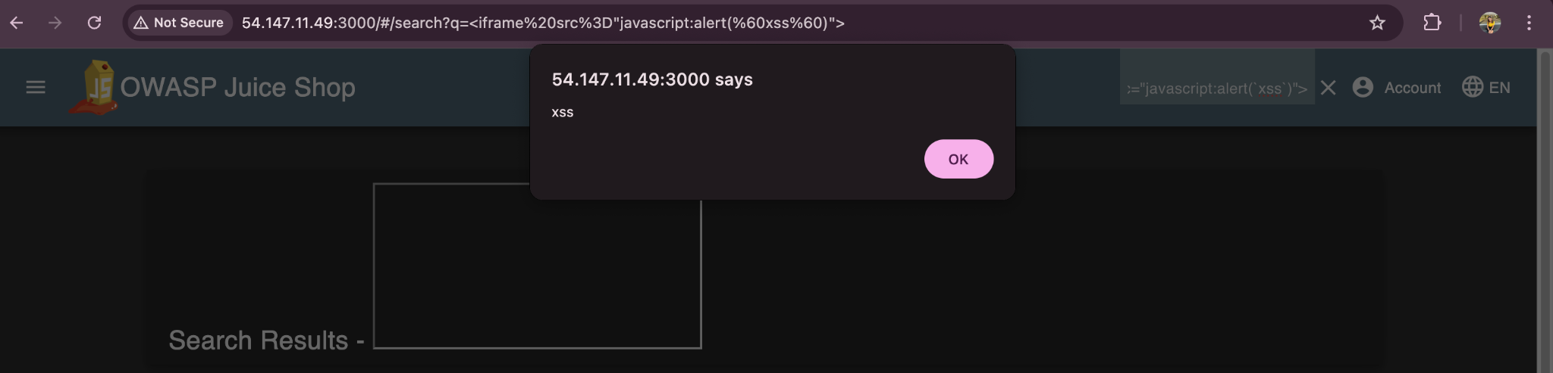
Cross Site Scripting :
Group - 4

Slide 10
Virtual Machine Vulnerabilities

Slide 11
Unrestricted sudo access for ec2-user with no password
The default ec2-user account is granted unrestricted sudo access without requiring any password
Unrestricted sudo access can lead to easy privilege escalation when the user is compromised
Higher privileges can lead to full system takeover, alter system configurations, and install malware
It is always recommended to follow the principle of least privilege
Group - 4

Slide 12
Unencrypted EBS Volume
The volume attached to the EC2 instance was not encrypted
Unencrypted EBS volumes store data in plain text
Leads to sensitive data exposure if an attacker gains access to it
It is always recommended to encrypt the data at rest
Group - 4

Slide 13
EC2 Termination Protection Not Enabled
EC2 termination protection is a feature in AWS that prevents an instance from being accidentally terminated
Unauthorized termination can lead to loss of availability and potential data corruption if systems are terminated improperly
It is recommended to enable termination protection to prevent such events
Group - 4

Slide 14
Network Security Assessment

Slide 15
1. SSH Open to 0.0.0.0/0
SSH (port 22) is open to the entire internet.
Exposes the EC2 instance to brute-force login attempts.
Allows any user to attempt remote access with a valid key.
Mitigations:
Restrict SSH access to specific IP ranges.
Rotate SSH key pairs regularly and enforce key policies

Slide 16
2. Public Subnet & IP
EC2 instance is deployed in a public subnet.
Public IP is assigned, exposing it directly to the internet.
No intermediary layer (e.g., Load Balancer or NAT).
Mitigations:
Move EC2 instance to a private subnet.
Remove public IPs from backend servers; use private IPs only.

Slide 17
3. Lack of Network Segmentation
Web app and database are on the same EC2 instance.
No separation between public, app, and database layers.
Flat network increases lateral movement risk.
Mitigations:
Use security groups to enforce tier-specific access.
Implement a three-tier VPC architecture: Private, Public, Isolated.

Slide 18
4. Lack of DDoS Protection
No AWS Shield, WAF, or CloudFront in place.
Application is directly exposed to volumetric and application-layer DDoS attacks.
Mitigations:
Use AWS WAF with rate-limiting and IP blocking rules.
Enable AWS Shield Standard (automatically included for all AWS customers).

Slide 19
5. Absence of VPC Flow Logs or Logging
No VPC Flow Logs or centralized logs in place.
Inability to detect suspicious traffic patterns or troubleshoot incidents.
Missed visibility for security monitoring and compliance.
Mitigations:
Enable VPC Flow Logs to capture accepted and rejected traffic.
Send logs to CloudWatch Logs or S3.

Slide 20
6. Absence of Load Balancer
No Load Balancer between users and the EC2 instance.
Direct traffic to EC2 increases risk and limits scalability.
No SSL offloading, health checks, or high availability.
Mitigations:
Deploy an Application Load Balancer (ALB) in the public subnet.
Route traffic securely to EC2 instances in private subnets

Slide 21
7. No IDS/IPS Solution
No Intrusion Detection or Prevention System is in place.
Lack of visibility into port scans, brute-force attempts, or lateral movement.
Non-compliance with best practices and security frameworks.
Mitigations:
Enable Amazon GuardDuty for real-time threat detection
Use AWS Network Firewall or third-party solutions for deeper inspection.

Slide 22
DATA SECURITY CREDENTIALS AND STORAGE

Slide 23
Data Credentials and Storage
OBSERVATION
Root database password is hardcoded in EC2 UserData and stored in plaintext.
IMPACT
Attacker with EC2 access can read the script
Weak, guessable password = high risk
Full database control: read/edit data, inject content.
RISK LEVEL : High
RECOMMENDATION
Use Secret Manager
Enforce strong, randomly generated passwords
Replace hardcoded secrets with secure, referenced credentials

Slide 24
ENCRYPTION AT REST
OBSERVATION
EBS volumes storing both the database and app are likely unencrypted per default CloudFormation settings.
IIMPACT
Exposed data if snapshot is leaked or accessed
Internal/third-party accidental access
Regulatory non-compliance (GDPR, HIPAA, PCI-DSS)
RISK LEVEL: High
RECOMMENDATIONS
Enable EBS encryption via EC2 Dashboard
Update CloudFormation to enforce encryption

Slide 25
ENCRYPTION IN TRANSIT
OBSERVATION
No SSL/TLS configured between app and local database
IMPACT
Plaintext data on internal network
Risk increases with horizontal scaling
Vulnerable to MITM attacks
Violates OWASP, CIS, and Zero Trust guidelines
RISK LEVEL: Medium
RECOMMENDATION
Configure SSL/TLS for MariaDB connections
Use encrypted client connections via Amazon RDS

Slide 26
SECRETS MANAGEMENT
OBSERVATION
Credentials are stored in plaintext scripts inside EC2
IMPACT
Easy access for attackers with EC2 permissions
Insider threats & compliance violations
Full DB access = data breaches & abuse
RISK LEVEL: High
RECOMMENDATION
Store credentials in AWS Secrets Manager or Parameter Store
Remove all plaintext secrets from instance scripts

Slide 27
Disaster Recovery Assessment

Slide 28
Single Availability Zone
The entire AWS Setup was created within a single availability zone - us-east-1 a.
If this availability zone goes down, the application will not be accessible by its users, resulting in downtime.
Recommendation - Multi-Availability zone deployment or cross-region zone setup, with AWS features like Elastic Load Balancers (ELB), Auto Scaling, etc., enabled. One of the availability zones/cross-region zones should be dedicatedly configured as a disaster recovery zone, containing replicas of VPCs, subnets, instances, etc., present in the other zones.
Group 4

Slide 29
2. No Automated Backup Plans Created
In case of accidental deletion/corruption of data due to human error, disasters, etc., there is no way of recovering it unless manual backups are taken, as there are no plans configured to automatically take backups of the EC2 instance. This could lead to the loss of critical business data.
Recommendation - Automate backups of instances periodically and store them in Amazon S3 buckets or EBS snapshots, for a specific retention period. Since the website (OWASP Juice Shop) is a live website, there should be daily full backup + incremental backups, and the retention period should be between 30-90 days to avoid the loss of critical data.
Group 4

Slide 30
3. No Load Balancers
Failure in the primary server will result in the downtime of the entire application, affecting the availability of resources to users and potentially leading to loss of revenue for the organization.
Recommendation - There should be Application Load Balancers or Network Load Balancers that would help distribute traffic, eliminate the risk of a single point of failure, and increase redundancy.
Group 4

Slide 31
4. Installation of MariaDB on an EC2 instance instead of AWS RDS
If the instance becomes unavailable or crashes, the database will no longer be accessible, and all its data will be lost. Running it on an instance also means that there are no automated backups, failovers, or high availability.
Since the database and the application both run on the same instance, that will make it very easy for the entire application to be compromised if the instance is compromised.
Recommendation - The database should be migrated to AWS RDS. If it is required to be on an EC2 instance, there should at least be a dedicated instance running just the database.
Group 4

Slide 32
5. EC2 Instance does not have a Snapshot Policy
No mechanism for rolling back the instance to a previous secure state.
The whole application instance would need to be manually rebuilt and installed.
Recommendation - create snapshots of the EC2 instance periodically using Amazon Image (AMI) snapshots or EBS snapshots so that in case of failure, the system can be restored and returned quickly to its original state, reducing downtime.
Group 4

Slide 33
6. No Redundancy in the Network
If there is an outage in the primary VPC/subnet/internet gateway, there is no disaster recovery site or failover networking components that the application can run on.
Recommendation - There should be more than one VPC/Subnet/Internet Gateway/Route Table. Having a replica of the network or having redundant networking components will improve business continuity and maintain application availability.
Group 4

Slide 34
7. No Disaster Recovery Documentation Exists
There were no Business Continuity Plans (BCPs), Incident Response Plans, RTO (Recovery Time Objective) & RPO (Recovery Point Objective) defined, no operational runbooks/playbooks.
This would result in extended downtime and impact business continuity.
Recommendation - A formalized incident response plan, RTO to understand affordable downtime without causing business harm, RPO defining manageable data loss, runbooks/playbooks to document detailed steps.
Group 4

Slide 35
Summary
Group 4's comprehensive assessment of the e-commerce application and cloud infrastructure has successfully identified several critical security vulnerabilities across the five pillars of AWS security. Through comprehensive security analysis, several issues and vulnerabilities were uncovered related to misconfigurations, weaknesses in data security, network segmentation, data loss, and extended downtime.
The detailed recommendations provide actionable steps to address these vulnerabilities, strengthen access controls, enhance encryption, and improve overall infrastructure security.
By implementing these measures, the e-commerce platform can ensure confidentiality, integrity, and availability of both the application and its data while aligning with industry’s best practices.
Group 4

